Slide 1
TREE

Slide 2
A tree is a non-linear data structure mainly used to represent data containing hierarchical relationship between elements.
A (general) tree T is defined as a finite set of elements such that
1- either it is empty (no nodes)
2- Or there is a special node in hierarchy called the root, and the remaining elements , if any, are partitioned into disjoint sets T₁,T₂,T₃---T_{n} where each of these sets is a tree, called the sub tree of T.
In other words, one may define a tree as a collection of nodes and each node is connected to another node through a branch. The nodes are connected in such a way that there are no loops in the tree and there is a distinguished node called the root of the tree.

Slide 3
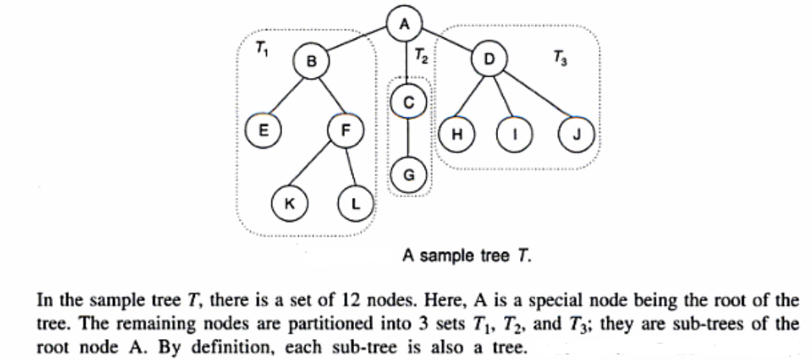


Slide 4
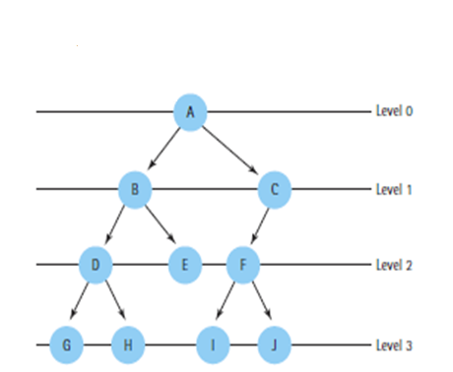
Tree Terminology
Parent node- Immediate predecessor of a node is called it’s parent. All the nodes except the root node have exactly one parent.
Child node- All the immediate successor of a node are known as it’s child.
Siblings- The child nodes with same parent are called siblings
Edge or Link- Line drawn from one node to other successor node is called an edge of a Tree.
Path- A sequence of edges is called an path
Leaf- A terminal node of a tree is called leaf node
Branch- Path ending in a leaf is called branch of the tree
Level of element- Each node in tree is assigned a level number. By definition, root of the tree is at level 0;its children,
if any, are at level 1; their children,
if any, are at level 2; and so on.
Thus a node is assigned a level number
one more than the level number of
its parent .

Slide 5
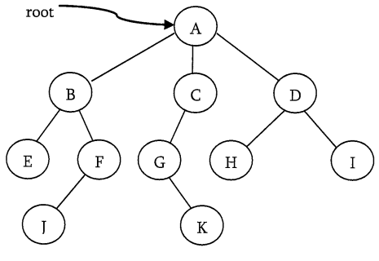
Ancestor/ Descendant- A node p is an ancestor of node q if there exist a path from root to q and p appears on the path. The node q is called a descendant of p.
Ex: A,C and G are Ancestor of K. K is descendant of A, C and G
Depth of a node- It is the length of path
from the root to the node.
Ex: Depth of G is 2(A-C-G)
Height of a node- It is the length of path
from that node to the deepest node.
Ex: Height of B is 2(B-F-J)
Height (or Depth) of a Tree- Maximum height among all the nodes in a tree and depth of a tree is maximum depth among all the nodes in the tree. For a given tree height and depth return the same value but for individual nodes they may have different value.
Note: In some books height (or depth) is equal to the maximum no. of nodes in a branch of Tree.
Degree of a node- The degree of a node is the number of its children.
Degree of Tree- The degree of a tree is the maximum degree of any of its nodes.

Slide 6
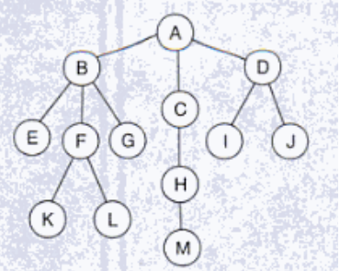
Question : Find the following with reference to given tree
1- height and depth of node B, node F
2- height of the Tree
3- level(H), level(C) and level(K)
4- degree of node F, node L, and degree of Tree
5- longest path in the tree
6- parent(M), child(B), sibling(L)
7- ancestors of node F
8- descendants of node B

Slide 7
The most common form of tree maintained in computer is binary tree.
Binary Tree- A binary tree T is defined as a finite set of elements, called nodes, such that either:
  T is empty (called null tree or empty tree) or,
  T contains a distinguished node, R, called root of T and remaining nodes of T form an ordered pair of disjoint binary trees T1 and T2
Two trees T1 and T2 are called respectively left and right subtree of R (root node of T). If T1 is nonempty, then its root is called left successor of R. Similarly, If T2 is nonempty, then its root is called right successor of R
A
B C
D E G H
F J K
L
The nodes D,F,G,L,K are the terminal or leaf nodes
Root Node
(Left Successor of A)
(Right Successor of A)

Slide 8
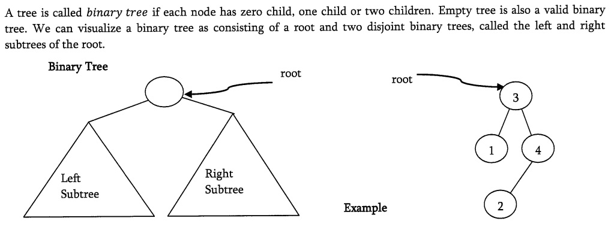
Binary Tree

Slide 9
Bianry trees are used to represent algebraic expressions involving only binary operations, such as
E= (a-b)/((c*d)+e)
Each variable or constant in E appears as an internal node in T whose left and right subtree correspond to operands of the expression
/
- +
a b * e
c d

Slide 10
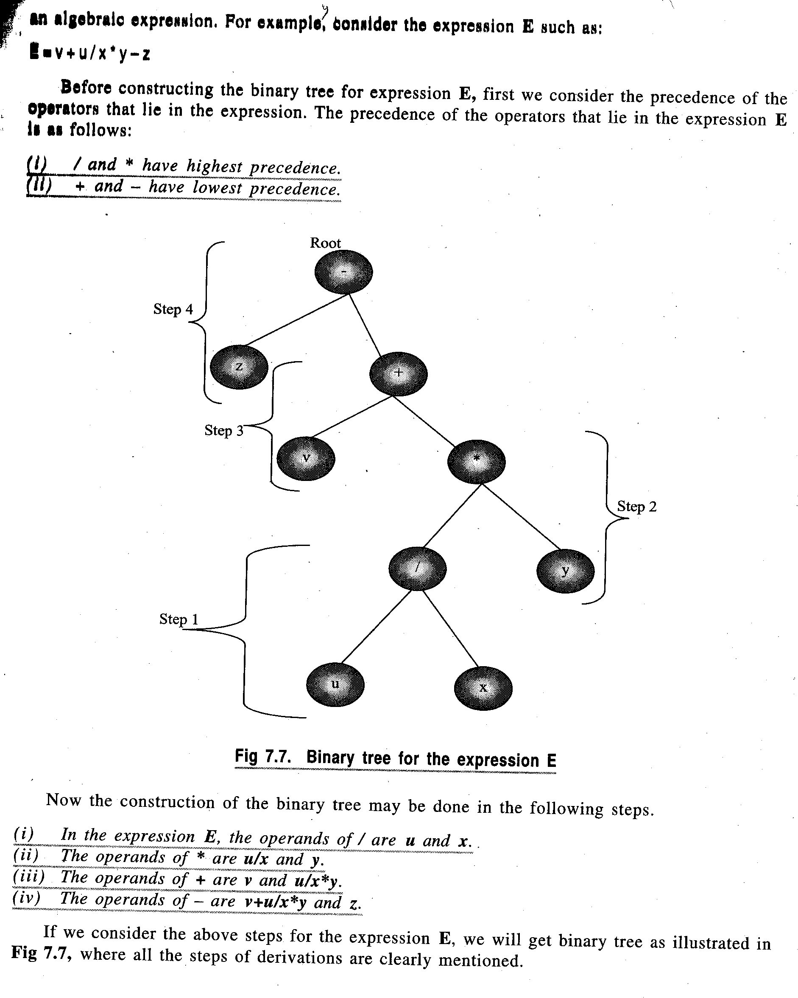
Before constructing a tree for an algebraic expression, we have to see the precedence of the operators involved in the expression.

Slide 11
Other Binary Trees
Complete Binary tree- A binary tree T is said to be complete if all its levels, except possibly the last, have maximum number of possible nodes, and if all the nodes at last level appear as far left as possible. Thus there is a unique complete tree T with exactly n nodes.
Full Binary Tree- A binary tree T is said to be complete if all its levels have maximum number of nodes(each level have 2^{l} nodes)
Extended Binary Trees: 2-Trees- A binary tree is said to be a 2-tree or an extended binary tree if each node N has either 0 or 2 children. In such a case, nodes with 2 children are called internal nodes, and nodes with 0 child are called external nodes.

Slide 12
Properties of Binary Trees
Each node of a binary tree T can have at most two children. Thus at level l of tree, there can be atmost 2^{l} nodes.
The Number of nodes in full binary tree at level l will be 2^{l+1} -1
The Number of nodes in complete binary tree at level l will be
in between 2^{l} (minimum) and 2^{l+1} -1 (maximum)
If tn in the total number of nodes in full binary tree, then height of tree, h = log2(tn + 1) - 1

Slide 13
Representing Binary Trees in memory
Sequential representation of Binary Trees- This representation uses only a single linear array Tree as follows:
The root R of T is stored in TREE[0]
If a node N occupies TREE[K], then its left child is stored in TREE[2*K+1] and its right child is stored in TREE[2*K+2] and parent is stored in TREE[(K-1)/2]
45
22 77
11 30 90
15 25 88

Slide 14
45
22
77
11
30
0
90
0
15
25
0
0
0
NULL
NULL
NULL
NULL
NULL
88

Slide 15
It can be seen that a sequential representation of a binary tree requires numbering of nodes; starting with nodes on level 1, then on level 2 and so on. The nodes are numbered from left to right .
It is an ideal case for representation of a complete binary tree and in this case no space is wasted.
However for other binary trees, most of the space remains unutilized. As can be seen in the figure, we require 14 locations in array even though the tree has only 9 nodes. If null entries for successors of the terminal nodes are included, we would actually require 29 locations instead of 14.Thus sequential representation is usually inefficient unless binary tree is complete or nearly complete

Slide 16
Linked representation of Binary Tree
In linked representation, Each node N of T will correspond to a location K such that INFO[K] contains data at node N. LEFT[K] contains the location of left child of node N and RIGHT[K] contains the location of right child of node N. ROOT will contain location of root R of Tree. If any subtree is empty, corresponding pointer will contain null value. If the tree T itself is empty, then ROOT will contain null value
ROOT
A
B
C
D
E
F
G
H
I
J

Slide 17
Traversing Binary Trees
There are three standard ways of traversing a binary tree T with root R. These are preorder, inorder and postorder traversals
Preorder
PROCESS the root R
Traverse the left sub tree of R in preorder
Traverse the right sub tree of R in preorder
Inorder
Traverse the left sub tree of R in inorder
Process the root R
Traverse the right sub tree of R in inorder
Postorder
Traverse the left sub tree of R in postorder
Traverse the right sub tree of R in postorder
Process the root R

Slide 18
The difference between the algorithms is the time at which the root R is processed. In pre algorithm, root R is processed before sub trees are traversed; in the in algorithm, root R is processed between traversals of sub trees and in post algorithm , the root is processed after the sub trees are traversed.
A
B C
D E F
Preorder Traversal: A B D E C F
Inorder Traversal: D B E A C F
Postorder Traversal : D E B F C A

Slide 19
All the traversal algorithms assume a binary tree T maintained in memory by linked representation
TREE(INFO,LEFT,RIGHT,ROOT)
All algorithms use a variable PTR(pointer) which will contain the location of the node N currently being scanned. LEFT[N] denotes the left child of node N and RIGHT[N] denotes the right child of N. All algorithms use an array STACK which will hold the addresses of nodes for further processing.

Slide 20
Algorithm: PREORD(INFO, LEFT, RIGHT, ROOT)
This algorithm traverses the tree in preorder
Step 1: Set TOP:=1, STACK[1]:=NULL and PTR:= ROOT
Step 2: Repeat Step 3 to 5 while PTR≠NULL
Step 3: Apply PROCESS to INFO[PTR]
Step 4: [Right Child ?]
If RIGHT[PTR] ≠ NULL, then:
Set TOP:=TOP + 1
Set STACK[TOP]:= RIGHT[PTR]
[End of If structure]
Step 5: [Left Child ?]
If LEFT[PTR] ≠ NULL, then:
Set PTR:=LEFT[PTR]
Else:
Set PTR:=STACK[TOP]
Set TOP:=TOP-1
[End of If structure]
[End of Step 2 Loop]
Step 6: Return

Slide 21
Algorithm: INORD (INFO, LEFT,RIGHT, ROOT)
Step 1: Set TOP:=1, STACK[1]:=NULL and PTR:=ROOT
Step 2: Repeat while PTR ≠ NULL:
(A) Set TOP:=TOP + 1 and STACK[TOP]:= PTR
(B) Set PTR:=LEFT[PTR]
[End of Loop]
Step 3: Set PTR:=STACK[TOP] and TOP:=TOP -1
Step 4: Repeat Step 5 to 7 while PTR ≠ NULL
Step 5: Apply PROCESS to INFO[PTR]
Step 6: If RIGHT[PTR] ≠ NULL, then:
(A) Set PTR := RIGHT[PTR]
(B) GO TO step 2
[End of If structure]
Step 7: Set PTR:=STACK[TOP] and TOP:=TOP -1
[End of Step 4 Loop]
Step 8: Return

Slide 22
Algorithm : POSTORD( INFO, LEFT, RIGHT, ROOT)
Step 1: Set TOP:=1, STACK[1]:=NULL and PTR:=ROOT
Step 2: Repeat Step 3 to 5 while PTR≠ NULL
Step 3: Set TOP:=TOP +1 and STACK[TOP]:=PTR
Step 4: If RIGHT[PTR]≠ NULL, then:
Set TOP:=TOP +1 and STACK[TOP]:= - RIGHT[PTR]
[End of If structure]
Step 5: Set PTR:=LEFT[PTR]
[End of Step 2 loop]
Step 6: Set PTR:=STACK[TOP] and TOP:=TOP -1
Step 7: Repeat while PTR>0:
(A) Apply PROCESS to INFO[PTR]
(B) Set PTR:=STACK[TOP] and TOP:=TOP -1
[End of Loop]
Step 8: If PTR<0, then:
(a) Set PTR:=-PTR
(b) Go to Step 2
[End of If structure]
Step 9: Exit

Slide 23
Problem: Create a tree from the given traversals
preorder: F A E K C D H G B
inorder: E A C K F H D B G
Solution: The tree is drawn from the root as follows:
The root of tree is obtained by choosing the first node of preorder. Thus F is the root of the proposed tree
The left child of the tree is obtained as follows:
  Use the inorder traversal to find the nodes to the left and right of the root node selected from preorder. All nodes to the left of root node(in this case F) in inorder form the left subtree of the root(in this case E A C K )
  All nodes to the right of root node (in this case F ) in inorder form the right subtree of the root (H D B G)
  Follow the above procedure again to find the subsequent roots and their subtrees on left and right.

Slide 24
F is the root Nodes on left subtree( left of F):E A C K (from inorder)
Nodes on right subtree(right of F):H D B G(from inorder)
The root of left subtree:
From preorder: A E K C , Thus the root of left subtree is A
D H G B , Thus the root of right subtree is D
Creating left subtree first:
From inorder: elements of left subtree of A are: E (root of left)
elements of right subtree of A are: C K (root of right)
Thus tree till now is:
F
A D
E K
C
As K is to the left of C in preorder

Slide 25
Creating the right subtree of F
The root node is D
From inorder, the nodes on the left of D are: H (left root of D)
the nodes on the right of D are: B G (right root of D)
Thus the tree is:
F
A D
E K H G
C B

Slide 26
F
A D
E K H G
C B

Slide 27
Ex:
Draw the tree :
Preorder: ABDGCEHIF
Inorder: DGBAHEICF
PostOrder: GDBHIEFCA

Slide 28
Binary Search Tree-
If T is a binary tree, then T is called a binary search tree or binary sorted tree if each node N of T has the following property:
  The Value of N is greater than every value in left sub tree of N
  The value at N is less than or equal to every value in right sub tree of N
The inorder traversal of BST gives sorted numbers
For example: The following numbers create a BST as:
3 5 9 1 2 6 8 10
3
1 5
2 9
6 10
8

Slide 29
Binary search tree is one of the most important data structures in computer science. This structure enables one to search for and find an element with an average running time
f(n)=O(log₂ n )
It also enables one to easily insert and delete elements. This structure contrasts with following structures:
    Sorted linear array- here one can find the element with a running time of O(log₂ n ) but it is expensive to insert and delete
    Linked list- Here one can easily insert and delete but searching is expensive with running time of O(n)

Slide 30
Searching and Inserting in a BST
Algorithm: This algorithm searches for ITEM in a tree and inserts it if
not present in tree
Step 1: Compare ITEM with root node N of Tree
(i) If ITEM < N, proceed to left child of N
(ii) If ITEM >= N, proceed to right child of N
Step 2: Repeat step 1 until one of the following occurs:
(i) If ITEM = N, then:
Write: ‘Search successful’
(ii) Empty sub tree found indicating search unsuccessful.
Insert item in place of empty sub tree

Slide 31
Algorithm: INSBT(INFO, LEFT, RIGHT, AVAIL, ITEM, LOC)
This algorithm finds the location LOC of an ITEM in T or adds ITEM as a new
node in T at location LOC
Step 1: Call FIND(INFO, LEFT, RIGHT, ROOT, ITEM, LOC, PAR)
Step 2: If LOC ≠ NULL, then
Return
Step 3: [Copy item into new node in AVAIL list]
(a) If AVAIL=NULL, then:
Write: ‘OVERFLOW’
Return
(b) Set NEW:=AVAIL, AVAIL:=LINK[AVAIL] and
INFO[NEW]:=ITEM
(c) Set LEFT[NEW]:=NULL and RIGHT[NEW]:=NULL
Step 4:[Add ITEM to tree]
If PAR=NULL, then:
Set ROOT:=NEW
Else If ITEM<INFO[PAR], then:
Set LEFT[PAR]:=NEW
Else:
Set RIGHT[PAR]:=NEW
[End of If structure]
Step 5: Return

Slide 32
Algorithm: FIND(INFO,LEFT,RIGHT,ROOT,ITEM,LOC,PAR)
This algorithm finds the location LOC of ITEM in T and also the location PAR of the parent of ITEM. There are three special cases
(a) LOC=NULL and PAR=NULL will indicate tree is empty
(b) LOC≠ NULL and PAR=NULL will indicate that ITEM is the root of T
(c) LOC=NULL and PAR ≠ NULL will indicate that ITEM is not in T and can be added to T as a child of node N with location PAR
Step 1: If ROOT= NULL , then:
Set LOC:=NULL and PAR:=NULL
Return
Step 2: Else:
Set PTR = ROOT and SAVE = NULL
Repeat while PTR ≠ NULL:
If ITEM=INFO[PTR] ,then:
Set LOC:=PTR and PAR:=SAVE and return
Else:
If ITEM< INFO[PTR] , then:
Set SAVE =PTR and PTR:=LEFT[PTR]
Else:
Set SAVE =PTR and PTR:=RIGHT[PTR]
[End of If structure]
[End of If structure]
[End of while Loop]
step 3: Set LOC:=NULL and PAR:=SAVE // [Search unsuccessful]
[End of If structure]
Step 4: Return

Slide 33
Deletion in a Binary Search Tree- Deletion in a BST uses a procedure FIND to find the location of node N which contains ITEM and also the location of parent node P(N). The way N is deleted from the tree depends primarily on the number of children of node N. There are three cases:
Case 1: N has no children. Then N is deleted from T by simply
replacing the location P(N) by null pointer
Case 2: N has exactly one child. Then N is deleted from T by simply
replacing the location of N by location of the only child of N
Case 3: N has two children. Let S(N) denote the inorder successor of
N. Then N is deleted from T by first deleting S(N) from T(by
using Case 1 or Case 2) and then replacing node N in T by
node S(N)

Slide 34
Algorithm: DEL( INFO, LEFT,RIGHT,ROOT,AVAIL,ITEM)
This procedure deletes ITEM from the tree.
1:[Find the location of ITEM and it’s parent]
call FIND(INFO,LEFT,RIGHT,ROOT,ITEM,LOC,PAR)
2.[ITEM in tree?]
If LOC=NULL, then: write: ITEM not in tree, and exit
3.[Delete node containing ITEM]
If RIGHT[LOC] ≠ NULL and LEFT[LOC] ≠ NULL, then:
call DELB( INFO, LEFT, RIGHT, ROOT, LOC, PAR)
Else:
call DELA( INFO, LEFT,RIGHT,ROOT,LOC,PAR)
[End of if structure]
4. [Return deleted node to the AVAIL list]
Set Right[LOC]= AVAIL and AVAIL = LOC
5. Exit.

Slide 35
Case 1: When node to be deleted does not have two children
Algorithm: DELA( INFO, LEFT,RIGHT,ROOT,LOC,PAR)
This procedure deletes node N at location LOC where N does not have two children. PAR gives the location of parent node of N or else PAR=NULL indicating N is the
root node. Pointer CHILD gives the location of only child of N
Step 1: If LEFT[LOC]=NULL and RIGHT[LOC]=NULL, then:
Set CHILD=NULL
Else If LEFT[LOC]≠NULL, then:
Set CHILD:=LEFT[LOC]
Else
Set CHILD:=RIGHT[LOC]
Step 2: If PAR ≠ NULL, then:
If LOC=LEFT[PAR] , then:
Set LEFT[PAR]:=CHILD
Else:
Set RIGHT[PAR]:=CHILD
Else:
Set ROOT:=CHILD
Step 3: Return

Slide 36
Case 2: When node to be deleted has two children
Algorithm: DELB( INFO, LEFT, RIGHT, ROOT, LOC, PAR)
This procedure PAR gives the location of parent node of N or else PAR=NULL indicating N is the root node. Pointer SUC gives the location of in order successor of N and PARSUC gives the location of parent of in order successor
Step 1: (a) Set PTR:=RIGHT[LOC] and SAVE:=LOC
(b) Repeat while LEFT[PTR]≠NULL
Set SAVE:=PTR and PTR:=LEFT[PTR]
[End of Loop]
(c ) Set SUC:=PTR and PARSUC:=SAVE
Step 2: CALL DELA(INFO,LEFT,RIGHT, ROOT,SUC,PARSUC)
Step 3: (a) If PAR ≠ NULL, then:
If LOC = LEFT [PAR], then:
Set LEFT[PAR]:=SUC
Else:
Set RIGHT[PAR]:=SUC
[End of If structure]
Else:
Set ROOT:=SUC
[End of If structure]
(b) Set LEFT[SUC]:=LEFT[LOC] and Set RIGHT[SUC]:=RIGHT[LOC]
Step 4: Return

Slide 37
AVL TREE

Slide 38
The efficiency of many important operations on trees is related to the height of the tree –for example searching, insertion and deletion in a BST are all O(height). In general, the relation between the height of the tree and the number of nodes of the tree is O (log₂n) except in the case of right skewed or left skewed BST in which height is O(n). The right skewed or left skewed BST is one in which the elements in the tree are either on the left or right side of the root node.
A A
B B
C C
D D
E E
Right-skewed
Left-skewed

Slide 39
For efficiency sake, we would like to guarantee that h remains O(log₂n). One way to do this is to force our trees to be height-balanced.
Method to check whether a tree is height balanced or not is as follows:
  Start at the leaves and work towards the root of the tree.
  Check the height of the subtrees(left and right) of the node.
  A tree is said to be height balanced if the difference of heights of its left and right subtrees of each node is equal to 0, 1 or -1
Example:
Check whether the shown tree is balanced or not

Slide 40
A
B C
D
Sol: Starting from the leaf nodes D and C, the height of left and right subtrees of C and D are each 0. Thus their difference is also 0
Check the height of subtrees of B
Height of left subtree of B is 1 and height of right subtree of B is 0. Thus the difference of two is 1 Thus B is not perfectly balanced but the tree is still considered to be height balanced.
Check the height of subtrees of A
Height of left subtree of A is 2 while the height of its right subtree is 1. The difference of two heights still lies within 1.
Thus for all nodes the tree is a balanced binary tree.

Slide 41
Check whether the shown tree is balanced or not
A
B F
C
D
E
Ans No as node B is not balanced as difference of heights of left and right subtrees is 3-0 i.e more than 1.

Slide 42
Height-balanced Binary tree (AVL Tree)
The disadvantage of a skewed binary search tree is that the worst case time complexity of a search is O(n). In order to overcome this disadvantage, it is necessray to maintain the binary search tree to be of balanced height. Two Russian mathematicians , G.M. Adel and E.M. Landis gave a technique to balance the height of a binary tree and the resulting tree is called AVL tree.
Definition: An empty binary tree is an AVL tree. A non empty binary tree T is an AVL tree iff given T^{L} and T^{R} to be the left and right subtrees of T and h(T^{L}) and h(T^{R}) be the heights of subtrees T^{L} and T^{R} respectively, T^{L} and T^{R} are AVL trees and |h(T^{L})-h(T^{R})| ≤ 1.
|h(T^{L})-h(T^{R})| is also called the balance factor (BF) and for an AVL tree the balance factor of a node can be either -1, 0 or 1
An AVL search tree is a binary search tree which is an AVL tree.

Slide 43
A node in a binary tree that does not contain the BF of 0, 1 or -1, it is said to be unbalanced. If one inserts a new node into a balanced binary tree at the leaf, then the possible changes in the status of the node are as follows:
The node was either left or right heavy and has now become balanced. A node is said to be left heavy if number of nodes in its left subtree are one more than the number of nodes in its right subtree.. In other words, the difference in heights is 1. Similar is the case with right heavy node where number of nodes in right subtree are one more than the number of nodes in left subtree
The node was balanced and has now become left or right heavy
The node was heavy and the new node has been inserted in the heavy subtree, thus creating an unbalanced subtree. Such a node is called a critical node.

Slide 44
Rotations- Inserting an element in an AVL search tree in its first phase is similar to that of the one used in a binary search tree. However, if after insertion of the element, the balance factor of any node in a binary search tree is affected so as to render the binary search tree unbalanced, we resort to techniques called Rotations to restore the balance of the search tree.
To perform rotations, it is necessary to identify the specific node A whose BF (balance factor) is neither 0,1 or -1 and which is nearest ancestor to the inserted node on the path from inserted node to the root.
The rebalancing rotations are classified as LL, LR, RR and RL based on the position of the inserted node with reference to A
LL rotation: Inserted node in the left subtree of the left subtree of A
RR rotation: Inserted node in the right subtree of the right subtree of A
LR rotation: Inserted node in the right subtree of the left subtree of A
RL rotation: Inserted node in the left subtree of the right subtree of A

Slide 45
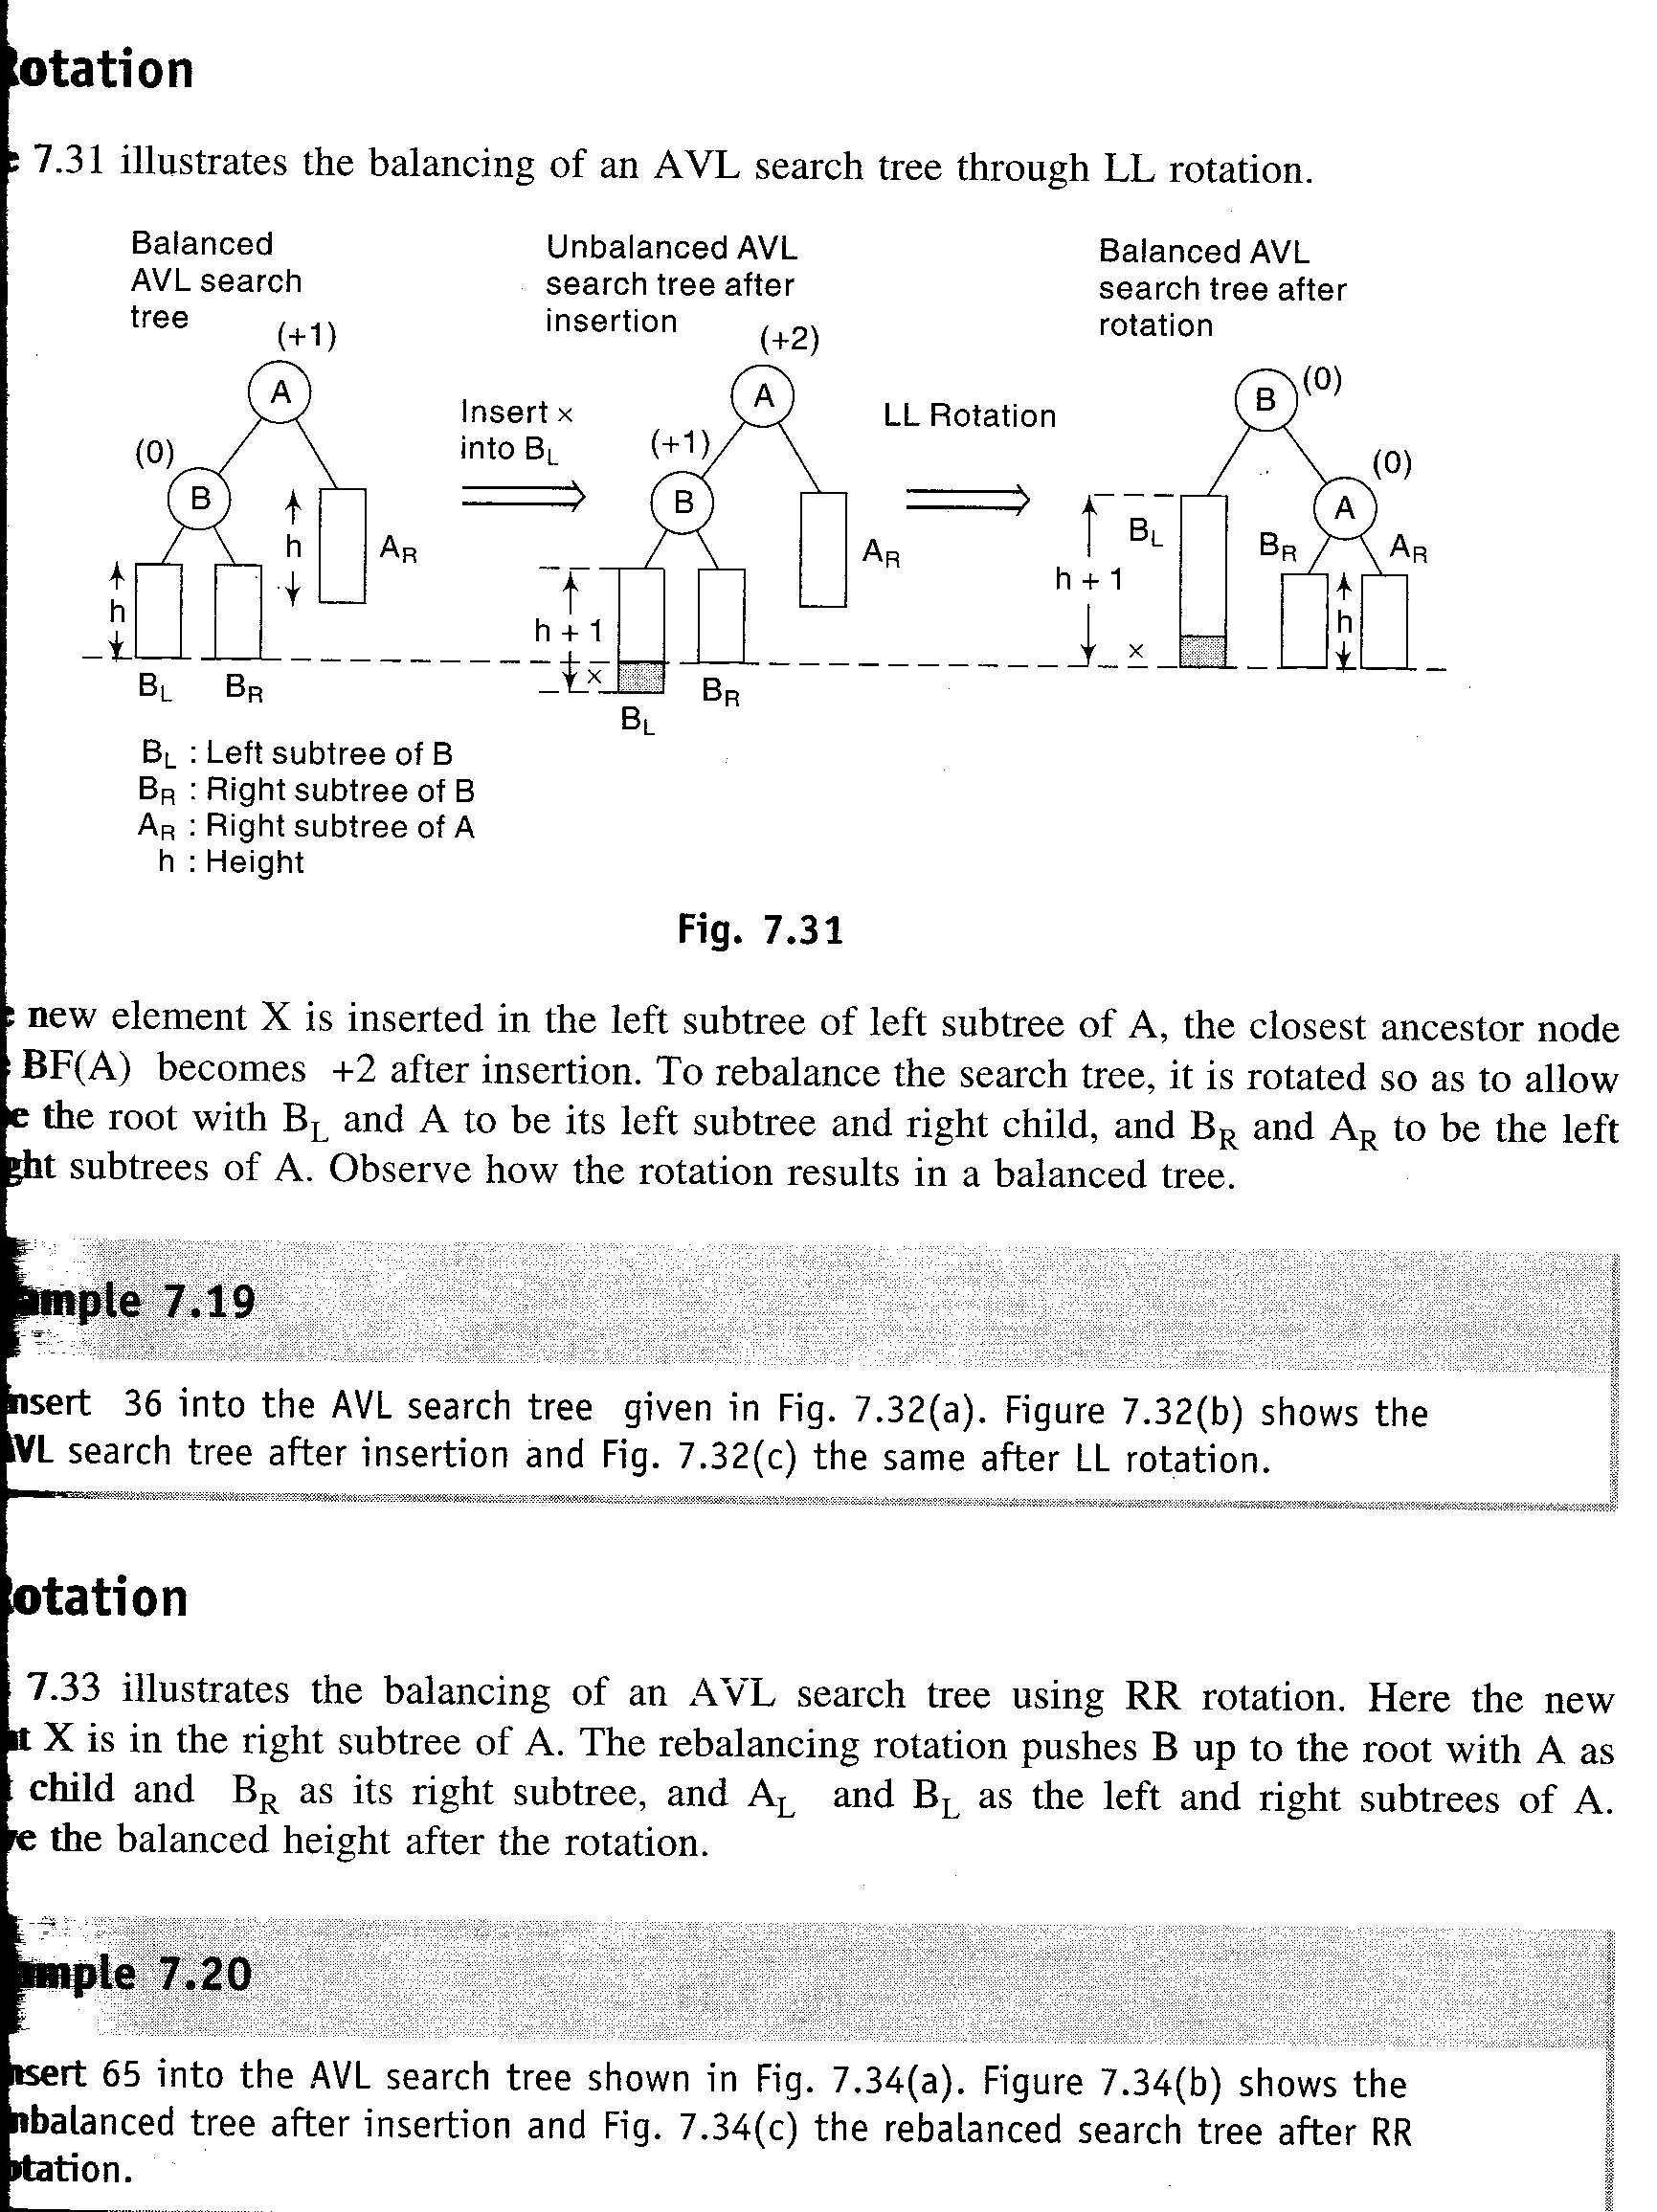
LL Rotation- This rotation is done when the element is inserted in the left subtree of the left subtree of A. To rebalance the tree, it is rotated so as to allow B to be the root with B_{L} and A to be its left subtree and right child and B_{R} and A_{R} to be the left and right subtrees of A. The rotation results in a balanced tree.

Slide 46
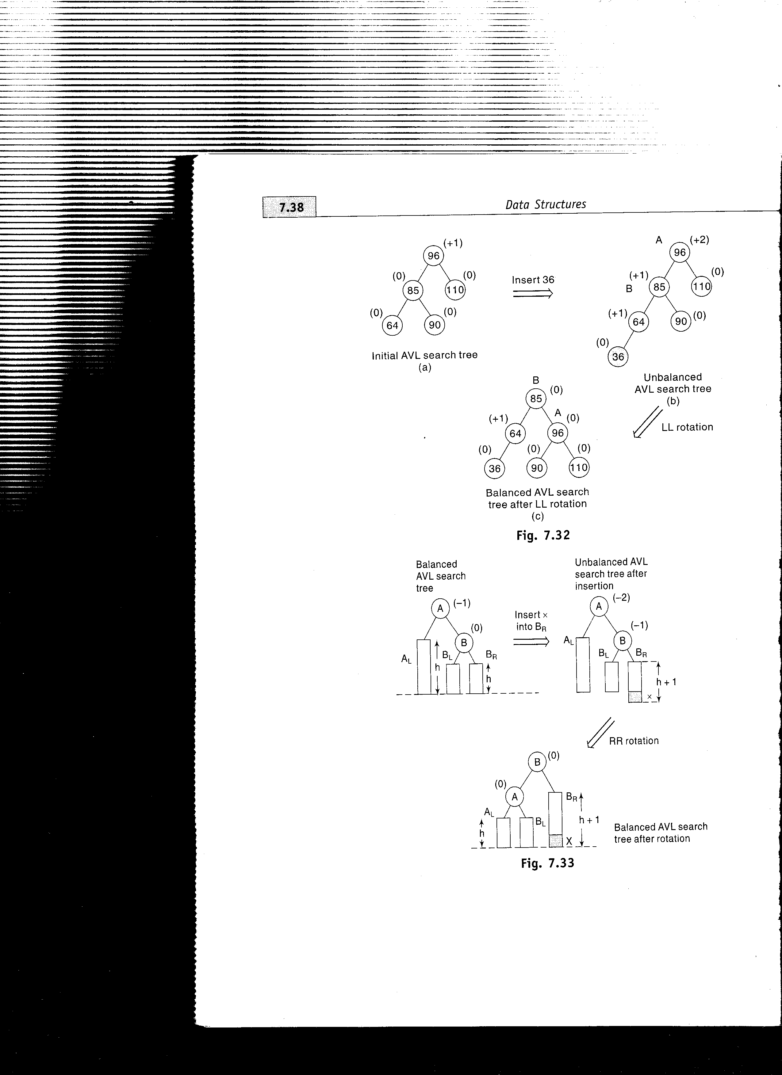

Slide 47
RR Rotation-This rotation is applied if the new element is inserted right subtree of right subtree of A. The rebalancing rotation pushes B upto the root with A as its left child and B_{R} as its right subtree and A_{L} and B_{L} as the left and right subtrees of A

Slide 48
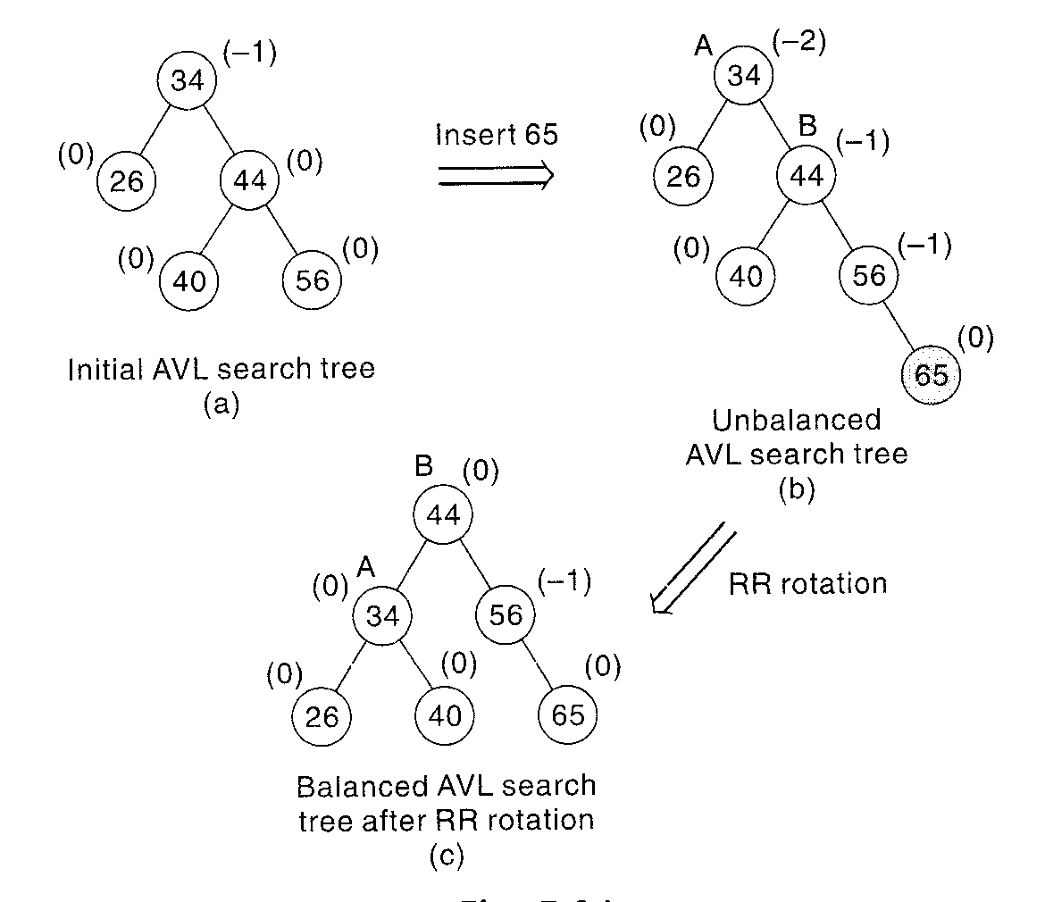

Slide 49
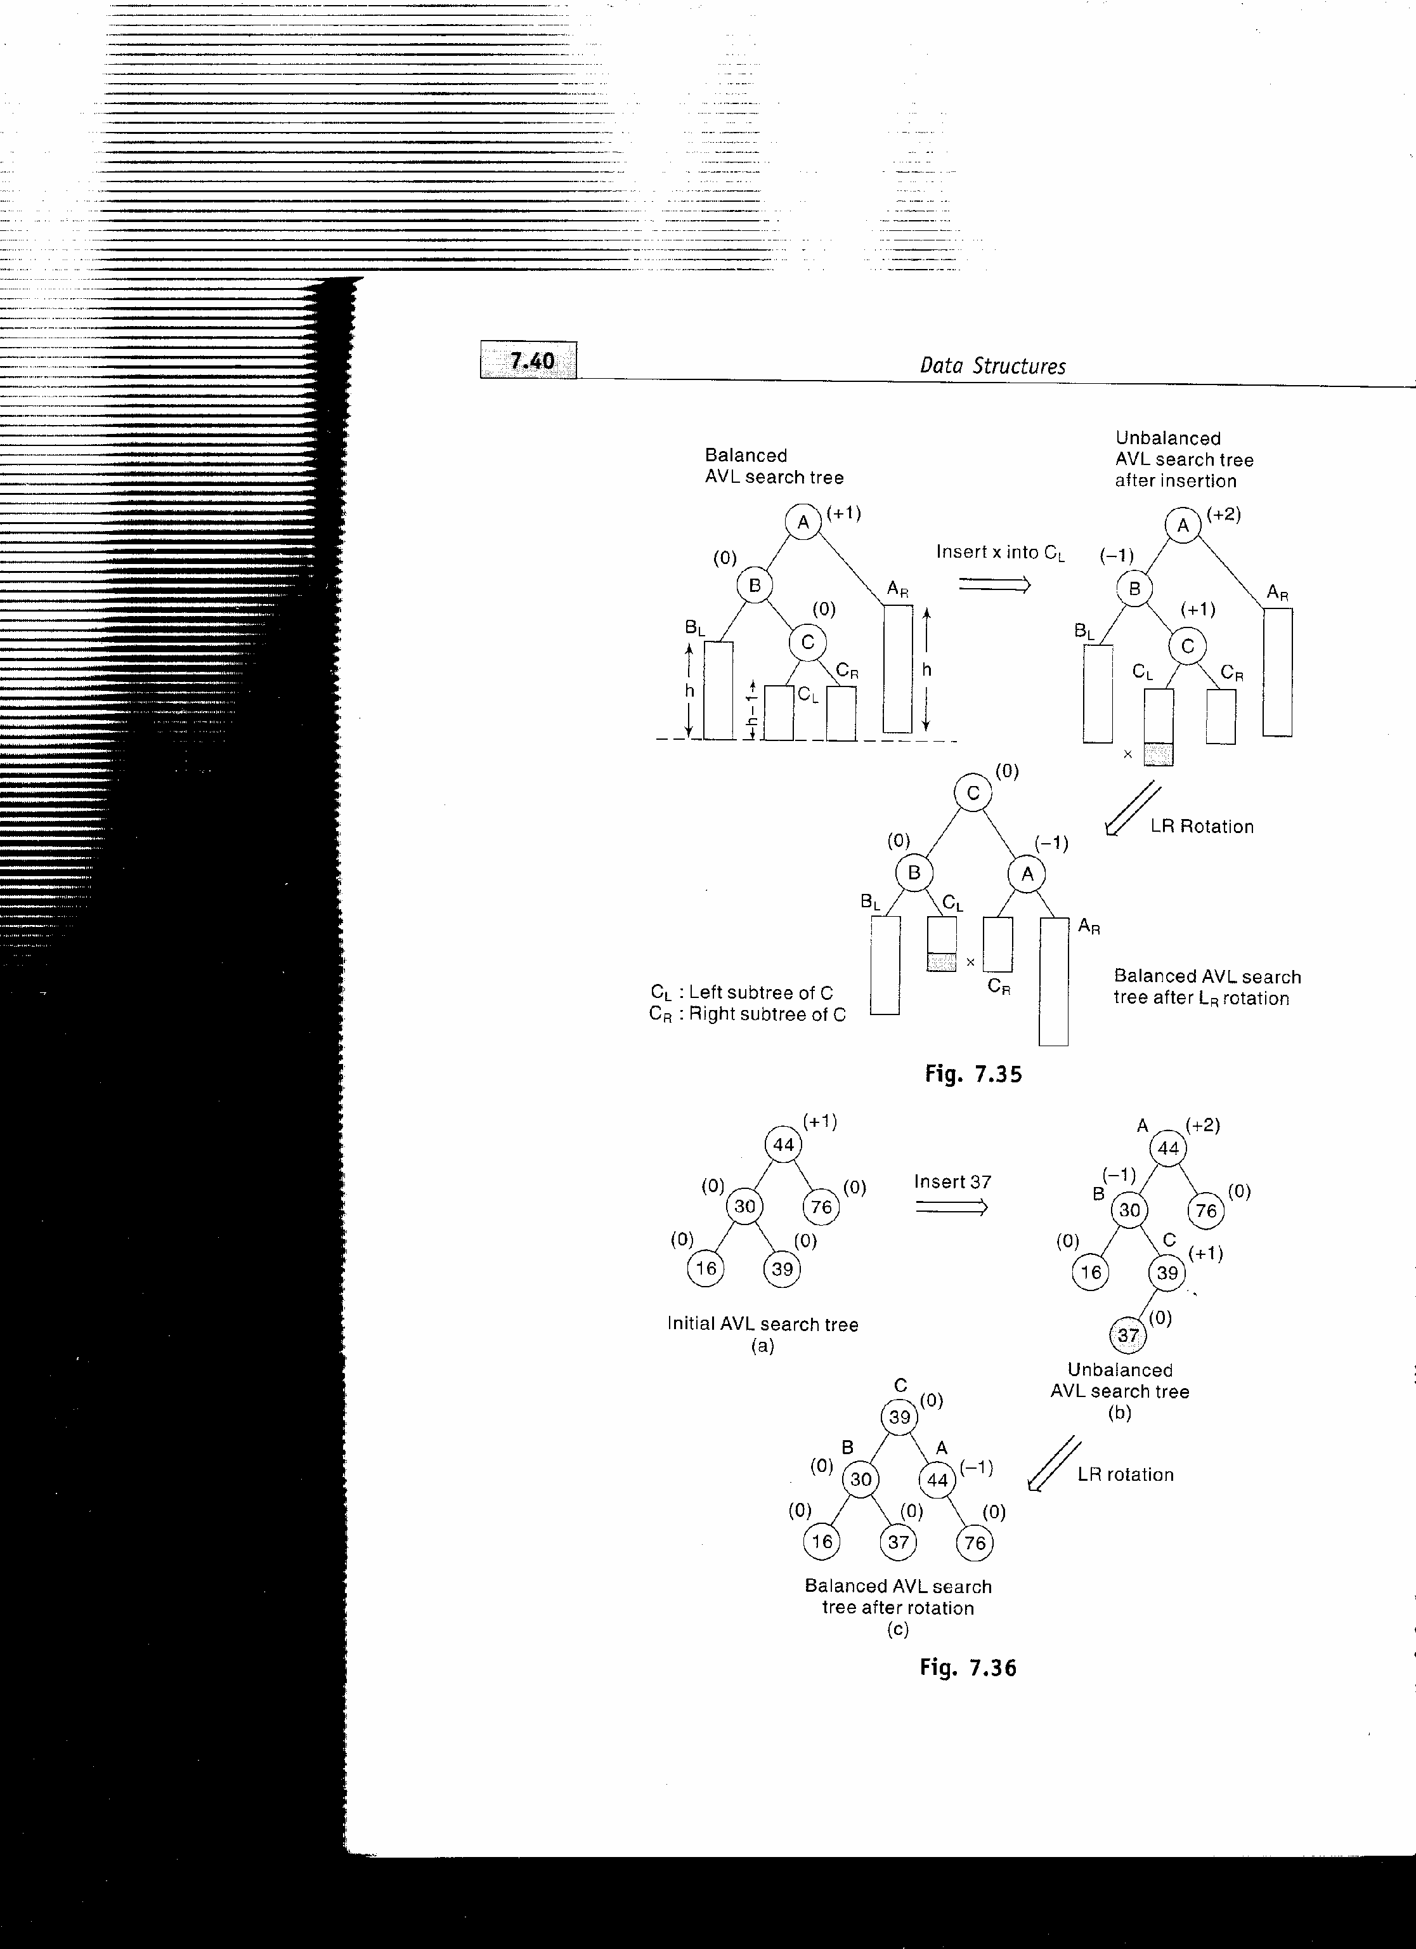
LR and RL rotations- The balancing methodology of LR and RL rotations are similar in nature but are mirror images of one another. Amongst the rotations, LL and RR rotations are called as single rotations and LR and RL are known as double rotations since LR is accomplished by RR followed by LL rotation and RL can be accomplished by LL followed by RR rotation. LR rotation is applied when the new element is inserted in right subtree of the left subtree of A. RL rotation is applied when the new element is inserted in the left subtree of right subtree of A

Slide 50
LR Rotation- this rotation is a combination of RR rotation followed by LL rotation.
A A C
B AR C AR B A
BL C B CR BL CL CR AR
CL CR BL CL x
x x
RR
LL

Slide 51
RL Rotation-This rotation occurs when the new node is inserted in left subtree of right subtree of A. It’s a combination of LL followed by RR
A C
T₁ B A B
C T₄ T₁ T₂ T₃ T₄
T₂ T₃ NEW
NEW
RL

Slide 52
RL Rotation- This rotation occurs when the new node is inserted in right subtree of left subtree of A.
A A
T₁ B T₁ C
C T₄ T₂ B
T₂ T₃ NEW T₃ T₄
NEW RR
C
A B
T1 T2 T3 T4
NEW
LL

Slide 54
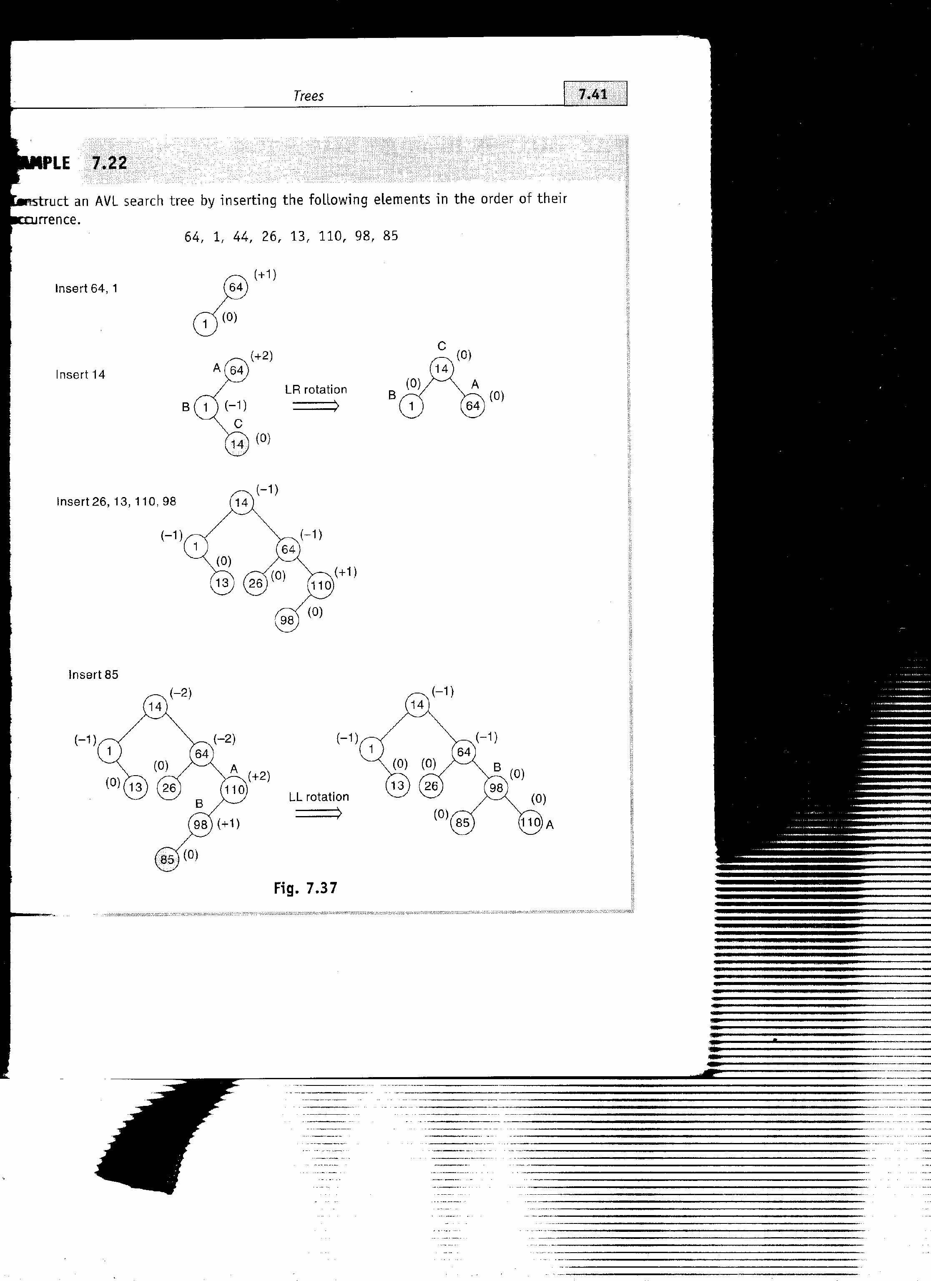
Problem: Construct an AVL search tree by inserting the following elements in the order of their occurrence
64, 1, 14, 26, 13, 110, 98, 85
Sol:

Slide 56
Deletion in an AVL search Tree
The deletion of element in AVL search tree leads to imbalance in the tree which is corrected using different rotations. The rotations are classified according to the place of the deleted node in the tree.
On deletion of a node X from AVL tree, let A be the closest ancestor node on the path from X to the root node with balance factor of +2 or -2 .To restore the balance, the deletion is classified as L or R depending on whether the deletion occurred on the left or right sub tree of A.
Depending on value of BF(B) where B is the root of left or right sub tree of A, the R or L rotation is further classified as R0, R1 and
R-1 or L0, L1 and L-1. The L rotations are the mirror images of their corresponding R rotations.

Slide 57
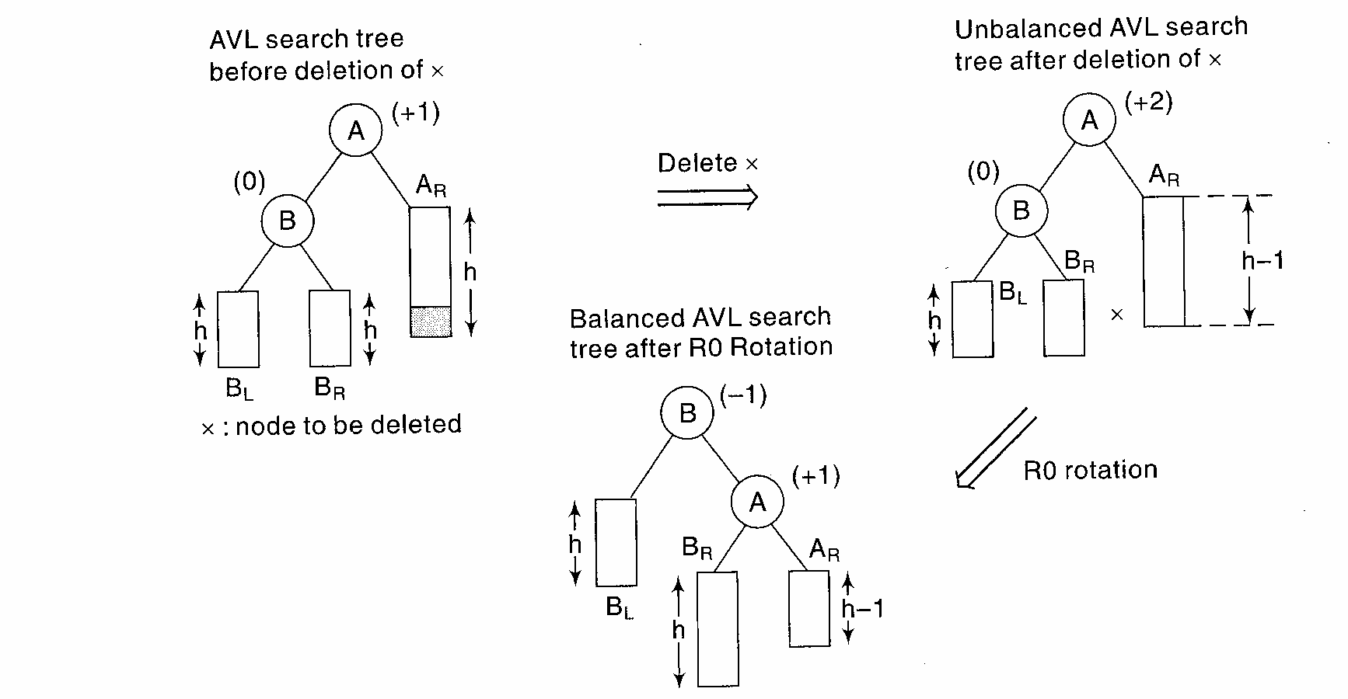
R0 Rotation- This rotation is applied when the BF of B is 0 after deletion of the node

Slide 58
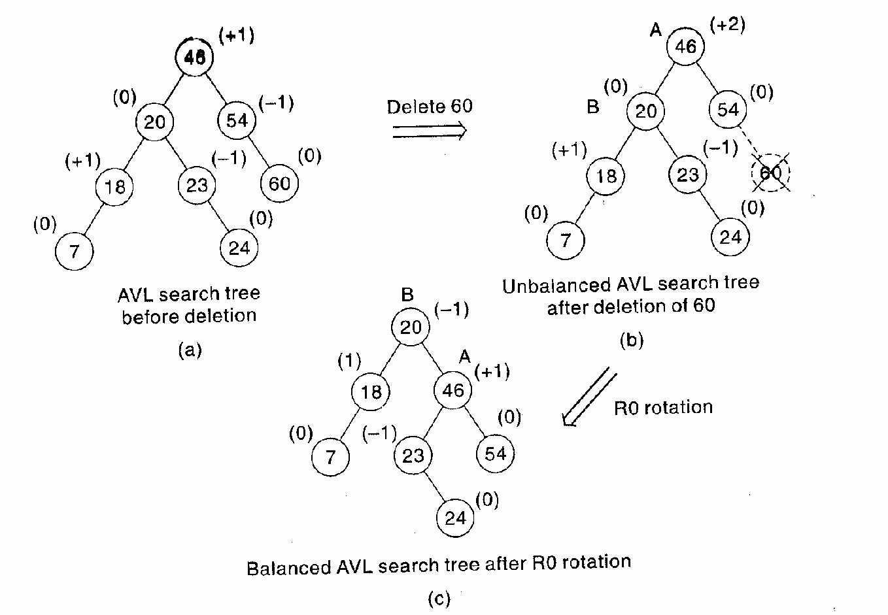

Slide 59
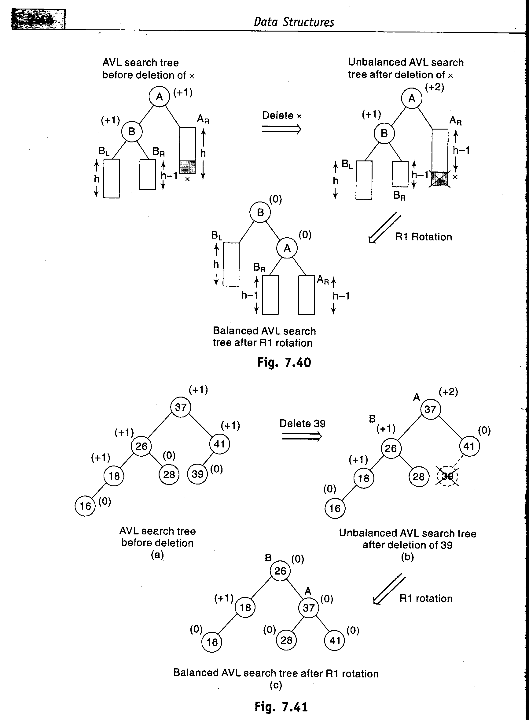
R1 Rotation- This rotation is applied when the BF of B is 1

Slide 61
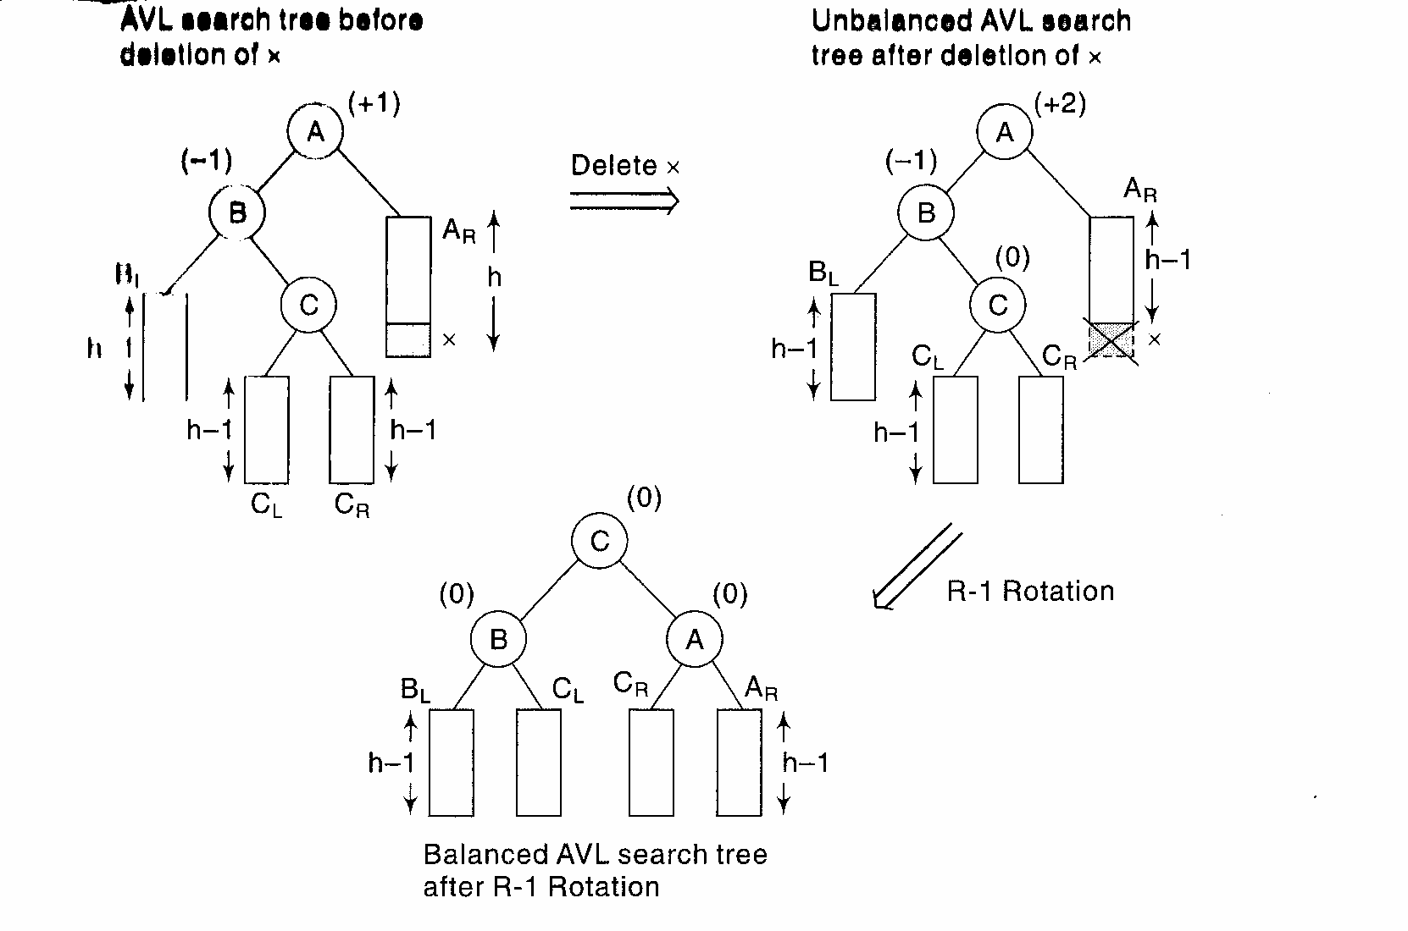
R-1 Rotation- This rotation is applied when the BF of B is -1

Slide 62
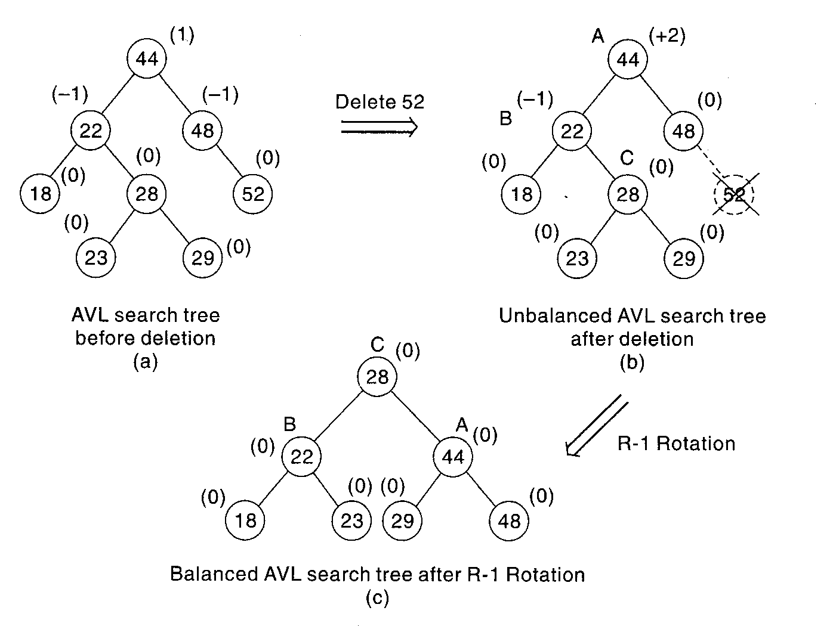

Slide 63
L rotations are the mirror images of R rotations. Thus L0 will be applied when the node is deleted from the left subtree of A and the BF of B in the right subtree is 0
Similarly, L1and L-1 will be applied on deleting a node from left subtree of A and if the BF of root node of right subtree of A is either 1 or -1 respectively.

Slide 64
Heap

Slide 65
Heap
Suppose H is a complete binary tree with n elements. Then H is called a heap or a maxheap if each node N of H has the property that value of N is greater than or equal to value at each of the children of N.
97
88 95
66 55 95 48
66 35 48 55 62 77 25 38
18 40 30 26 24

Slide 66
Analogously, a minheap is a heap such that value at N is less than or equal to the value of each of its children. Heap is more efficiently implemented through array rather than linked list. In a heap, the location of parent of a node PTR is given by PTR/2
Inserting an element in a Heap
Suppose H is a heap with N elements, and suppose an ITEM of information is given. We insert ITEM into the heap H as follows:
First adjoin the ITEM at the end of H so that H is still a complete tree but not necessarily a heap
Then let the ITEM rise to its appropriate place in H so that H is finally a heap

Slide 67
Algorithm: INSHEAP( TREE, N, ITEM)
A heap H with N elements is stored in the array TREE and an ITEM of
information is given. This procedure inserts the ITEM as the new element
of H. PTR gives the location of ITEM as it rises in the tree and PAR
denotes the parent of ITEM
Step 1: Set N:= N +1 and PTR:=N
Step 2: Repeat Step 3 to 6 while PTR > 1
Set PAR:=PTR/2
If ITEM ≤ TREE[PAR], then:
Set TREE[PTR]:=ITEM
Return
Set TREE[PTR]:=TREE[PAR]
[End of If structure]
Set PTR:=PAR
[End of Loop]
Step 3: Set TREE[1]:=ITEM
Step 4: Return

Slide 68
Deleting the root node in a heap
Suppose H is a heap with N elements and suppose we want to delete the root R of H. This is accomplished as follows:
Assign the root R to some variable ITEM
Replace the deleted node R by last node L of H so that H is still a complete tree but not necessarily a heap
Let L sink to its appropriate place in H so that H is finally a heap

Slide 69
Algorithm: DELHEAP( TREE, N , ITEM )
A heap H with N elements is stored in the array TREE.
This algorithm assigns the root TREE[1] of H to the
variable ITEM and then reheaps the remaining elements.
The variable LAST stores the value of the original last
node of H. The pointers PTR, LEFT and RIGHT give the
location of LAST and its left and right children as LAST
sinks into the tree.
Step 1: Set ITEM:=TREE[1]
Step 2: Set LAST:=TREE[N] and N:=N-1
Step 3: Set PTR:=1, LEFT:=2 and RIGHT:=3
Step 4: Repeat step 5 to 7 while RIGHT ≤ N:
Step 5: If LAST ≥ TREE[LEFT] and LAST ≥ TREE [RIGHT] , then:
Set TREE[PTR]:=LAST
Return

Slide 70
Step 6: If TREE[RIGHT]≤ TREE[LEFT], then:
Set TREE[PTR]:=TREE[LEFT]
Set PTR:=LEFT
Else:
Set TREE[PTR]:=TREE[RIGHT] and PTR:=RIGHT
[End of If structure]
Set LEFT:= 2* PTR and RIGHT:=LEFT + 1
[End of Loop]
Step 7: If LEFT=N and If LAST < TREE[LEFT], then:
Set TREE[PTR]:=TREE[LEFT] and Set PTR:=LEFT
Step 8: Set TREE[PTR]:=LAST
Return

Slide 71
90
80 85
60 50 75 70

Slide 72
Application of Heap
HeapSort- One of the important applications of heap is sorting of an array using heapsort method. Suppose an array A with N elements is to be sorted. The heapsort algorithm sorts the array in two phases:
Phase A: Build a heap H out of the elements of A
Phase B: Repeatedly delete the root element of H
Since the root element of heap contains the largest element of the heap, phase B deletes the elements in decreasing order. Similarly, using heapsort in minheap sorts the elements in increasing order as then the root represents the smallest element of the heap.

Slide 73
Algorithm: HEAPSORT(A,N)
An array A with N elements is given. This algorithm sorts
the elements of the array
Step 1: [Build a heap H]
Repeat for J=1 to N-1:
Call INSHEAP(A, J, A[J+1])
[End of Loop]
Step 2: [Sort A repeatedly deleting the root of H]
Repeat while N > 1:
(a) Call DELHEAP( A, N, ITEM)
(b) Set A[N + 1] := ITEM [Store the elements deleted from
the heap]
[End of loop]
Step 3: Exit

Slide 74
Huffman Coding
An Application of Binary Trees and Priority Queues

Slide 75
Encoding and Compression of Data
Fax Machines
ASCII
Variations on ASCII
  min number of bits needed
  cost of savings
  patterns
  modifications

Slide 76
Purpose of Huffman Coding
Proposed by Dr. David A. Huffman in 1952
  “A Method for the Construction of Minimum Redundancy Codes”
Applicable to many forms of data transmission
  Our example: text files
Notes:
An Introduction to Huffman Coding
March 21, 2000
Mike Scott

Slide 77
The Basic Algorithm
Huffman coding is a form of statistical coding
Not all characters occur with the same frequency!
Yet all characters are allocated the same amount of space
  1 char = 1 byte, be it e or x
Any savings in tailoring codes to frequency of character?
Code word lengths are no longer fixed like ASCII.
Code word lengths vary and will be shorter for the more frequently used characters.
Notes:
An Introduction to Huffman Coding
March 21, 2000
Mike Scott

Slide 78
The (Real) Basic Algorithm
Scan text to be compressed and tally occurrence of all characters.
Sort or prioritize characters based on number of occurrences in text.
Build Huffman code tree based on prioritized list.
Perform a traversal of tree to determine all code words.
Scan text again and create new file using the Huffman codes.
Notes:
An Introduction to Huffman Coding
March 21, 2000
Mike Scott

Slide 79
Building a Tree
Scan the original text
Consider the following short text:
Eerie eyes seen near lake.
Count up the occurrences of all characters in the text
Notes:
An Introduction to Huffman Coding
March 21, 2000
Mike Scott

Slide 80
Building a Tree
Scan the original text
Eerie eyes seen near lake.
What characters are present?
E e r i space
y s n a r l k .
Notes:
An Introduction to Huffman Coding
March 21, 2000
Mike Scott

Slide 81
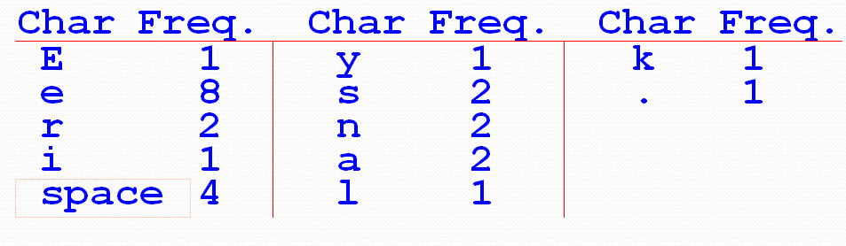
Building a Tree
Scan the original text
Eerie eyes seen near lake.
What is the frequency of each character in the text?
Notes:
An Introduction to Huffman Coding
March 21, 2000
Mike Scott

Slide 82
Building a Tree
Prioritize characters
Create binary tree nodes with character and frequency of each character
Place nodes in a priority queue
  The lower the occurrence, the higher the priority in the queue
Notes:
An Introduction to Huffman Coding
March 21, 2000
Mike Scott

Slide 83
Building a Tree
Prioritize characters
Uses binary tree nodes
    public class HuffNode
    {
    public char myChar;
    public int myFrequency;
    public HuffNode myLeft, myRight;
    }
priorityQueue myQueue;
Notes:
An Introduction to Huffman Coding
March 21, 2000
Mike Scott

Slide 84
Building a Tree
The queue after inserting all nodes
Null Pointers are not shown
E
1
i
1
y
1
l
1
k
1
.
1
r
2
s
2
n
2
a
2
sp
4
e
8
CS 102
Notes:
An Introduction to Huffman Coding
March 21, 2000
Mike Scott

Slide 85
Building a Tree
While priority queue contains two or more nodes
  Create new node
  Dequeue node and make it left subtree
  Dequeue next node and make it right subtree
  Frequency of new node equals sum of frequency of left and right children
  Enqueue new node back into queue
Notes:
An Introduction to Huffman Coding
March 21, 2000
Mike Scott

Slide 86
Building a Tree
E
1
i
1
y
1
l
1
k
1
.
1
r
2
s
2
n
2
a
2
sp
4
e
8
Notes:
An Introduction to Huffman Coding
March 21, 2000
Mike Scott

Slide 87
Building a Tree
y
1
l
1
k
1
.
1
r
2
s
2
n
2
a
2
sp
4
e
8
2
E
1
i
1
Notes:
An Introduction to Huffman Coding
March 21, 2000
Mike Scott

Slide 88
Building a Tree
y
1
l
1
k
1
.
1
r
2
s
2
n
2
a
2
2
sp
4
e
8
E
1
i
1
Notes:
An Introduction to Huffman Coding
March 21, 2000
Mike Scott

Slide 89
Building a Tree
k
1
.
1
r
2
s
2
n
2
a
2
2
sp
4
e
8
E
1
i
1
2
y
1
l
1
Notes:
An Introduction to Huffman Coding
March 21, 2000
Mike Scott

Slide 90
Building a Tree
k
1
.
1
r
2
s
2
n
2
a
2
2
2
sp
4
e
8
y
1
l
1
E
1
i
1
Notes:
An Introduction to Huffman Coding
March 21, 2000
Mike Scott

Slide 91
Building a Tree
r
2
s
2
n
2
a
2
2
2
sp
4
e
8
y
1
l
1
E
1
i
1
2
k
1
.
1
Notes:
An Introduction to Huffman Coding
March 21, 2000
Mike Scott

Slide 92
Building a Tree
r
2
s
2
n
2
a
2
2
2
sp
4
e
8
2
E
1
i
1
y
1
l
1
k
1
.
1
Notes:
An Introduction to Huffman Coding
March 21, 2000
Mike Scott

Slide 93
Building a Tree
n
2
a
2
2
sp
4
e
8
2
2
E
1
i
1
y
1
l
1
k
1
.
1
4
r
2
s
2
Notes:
An Introduction to Huffman Coding
March 21, 2000
Mike Scott

Slide 94
Building a Tree
n
2
a
2
2
sp
4
e
8
2
2
4
E
1
i
1
y
1
l
1
k
1
.
1
r
2
s
2
Notes:
An Introduction to Huffman Coding
March 21, 2000
Mike Scott

Slide 95
Building a Tree
2
4
e
8
2
2
sp
4
y
1
l
1
k
1
.
1
r
2
s
2
E
1
i
1
4
n
2
a
2
Notes:
An Introduction to Huffman Coding
March 21, 2000
Mike Scott

Slide 96
Building a Tree
2
4
4
e
8
2
2
sp
4
y
1
l
1
k
1
.
1
r
2
s
2
n
2
a
2
E
1
i
1
Notes:
An Introduction to Huffman Coding
March 21, 2000
Mike Scott

Slide 97
Building a Tree
4
4
e
8
2
sp
4
k
1
.
1
r
2
s
2
n
2
a
2
4
2
2
E
1
i
1
y
1
l
1
Notes:
An Introduction to Huffman Coding
March 21, 2000
Mike Scott

Slide 98
Building a Tree
2
4
4
4
sp
4
e
8
2
2
k
1
.
1
r
2
s
2
n
2
a
2
E
1
i
1
y
1
l
1
Notes:
An Introduction to Huffman Coding
March 21, 2000
Mike Scott

Slide 99
Building a Tree
4
4
4
e
8
2
2
r
2
s
2
n
2
a
2
E
1
i
1
y
1
l
1
6
2
sp
4
k
1
.
1
Notes:
An Introduction to Huffman Coding
March 21, 2000
Mike Scott

Slide 100
Building a Tree
4
4
4
6
e
8
2
sp
4
r
2
s
2
n
2
a
2
2
2
k
1
.
1
E
1
i
1
y
1
l
1
What is happening to the characters with a low number of occurrences?
Notes:
An Introduction to Huffman Coding
March 21, 2000
Mike Scott

Slide 101
Building a Tree
4
6
e
8
2
2
2
sp
4
E
1
i
1
y
1
l
1
k
1
.
1
8
4
4
r
2
s
2
n
2
a
2
Notes:
An Introduction to Huffman Coding
March 21, 2000
Mike Scott

Slide 102
Building a Tree
4
6
e
8
8
2
2
2
sp
4
4
4
E
1
i
1
y
1
l
1
k
1
.
1
r
2
s
2
n
2
a
2
Notes:
An Introduction to Huffman Coding
March 21, 2000
Mike Scott

Slide 103
Building a Tree
e
8
8
4
4
10
r
2
s
2
n
2
a
2
4
6
2
2
2
sp
4
E
1
i
1
y
1
l
1
k
1
.
1
Notes:
An Introduction to Huffman Coding
March 21, 2000
Mike Scott

Slide 104
Building a Tree
e
8
8
10
4
4
4
6
n
2
a
2
2
2
2
r
2
s
2
sp
4
E
1
i
1
y
1
l
1
k
1
.
1
Notes:
An Introduction to Huffman Coding
March 21, 2000
Mike Scott

Slide 105
Building a Tree
10
16
4
6
2
2
2
e
8
8
sp
4
E
1
i
1
y
1
l
1
k
1
.
1
4
4
r
2
s
2
n
2
a
2
Notes:
An Introduction to Huffman Coding
March 21, 2000
Mike Scott

Slide 106
Building a Tree
10
16
4
6
e
8
8
2
2
2
sp
4
4
4
E
1
i
1
y
1
l
1
k
1
.
1
r
2
s
2
n
2
a
2
Notes:
An Introduction to Huffman Coding
March 21, 2000
Mike Scott

Slide 107
Building a Tree
26
16
10
4
e
8
8
6
2
2
2
sp
4
4
4
E
1
i
1
y
1
l
1
k
1
.
1
r
2
s
2
n
2
a
2
Notes:
An Introduction to Huffman Coding
March 21, 2000
Mike Scott

Slide 108
Building a Tree
After enqueueing this node there is only one node left in priority queue.
26
16
10
4
e
8
8
6
2
2
2
sp
4
4
4
E
1
i
1
y
1
l
1
k
1
.
1
r
2
s
2
n
2
a
2
Notes:
An Introduction to Huffman Coding
March 21, 2000
Mike Scott

Slide 109
Building a Tree
Dequeue the single node left in the queue.
This tree contains the new code words for each character.
Frequency of root node should equal number of characters in text.
26
16
10
4
e
8
8
6
2
2
2
4
sp
4
4
E
1
i
1
y
1
l
1
k
1
.
1
r
2
s
2
n
2
a
2
Notes:
An Introduction to Huffman Coding
March 21, 2000
Mike Scott

Slide 110
Encoding the File
Traverse Tree for Codes
Perform a traversal of the tree to obtain new code words
Going left is a 0 going right is a 1
code word is only completed when a leaf node is reached
26
16
10
4
e
8
8
6
2
2
2
4
sp
4
4
E
1
i
1
y
1
l
1
k
1
.
1
r
2
s
2
n
2
a
2
Notes:
An Introduction to Huffman Coding
March 21, 2000
Mike Scott

Slide 111
Encoding the File
Traverse Tree for Codes
Char Code
E 0000
i 0001
y 0010
l 0011
k 0100
. 0101
space 011
e 10
r 1100
s 1101
n 1110
a 1111
26
16
10
4
e
8
8
6
2
2
2
4
sp
4
4
E
1
i
1
y
1
l
1
k
1
.
1
r
2
s
2
n
2
a
2
Notes:
An Introduction to Huffman Coding
March 21, 2000
Mike Scott

Slide 112
Encoding the File
Rescan text and encode file using new code words
Eerie eyes seen near lake.
Char Code
E 0000
i 0001
y 0010
l 0011
k 0100
. 0101
space 011
e 10
r 1100
s 1101
n 1110
a 1111
0000101100000110011100010101101101001111101011111100011001111110100100101
Why is there no need for a separator character?
Notes:
An Introduction to Huffman Coding
March 21, 2000
Mike Scott

Slide 113
Encoding the File
Results
Have we made things any better?
73 bits to encode the text
ASCII would take 8 * 26 = 208 bits
0000101100000110011100010101101101001111101011111100011001111110100100101
If modified code used 4 bits per
character are needed. Total bits
4 * 26 = 104. Savings not as great.
Notes:
An Introduction to Huffman Coding
March 21, 2000
Mike Scott

Slide 114
Decoding the File
How does receiver know what the codes are?
Tree constructed for each text file.
  Considers frequency for each file
  Big hit on compression, especially for smaller files
Tree predetermined
  based on statistical analysis of text files or file types
Data transmission is bit based versus byte based
Notes:
An Introduction to Huffman Coding
March 21, 2000
Mike Scott

Slide 115
Decoding the File
Once receiver has tree it scans incoming bit stream
0 ⇒ go left
1 ⇒ go right
26
16
10
4
e
8
8
0000101100000110011100010101101101001111101011111100011001111110100100101
6
2
2
2
4
sp
4
4
E
1
i
1
y
1
l
1
k
1
.
1
r
2
s
2
n
2
a
2
10100011011110111101111110000110101

Slide 116
Summary
Huffman coding is a technique used to compress files for transmission
Uses statistical coding
  more frequently used symbols have shorter code words
Works well for text and fax transmissions
An application that uses several data structures

Slide 117
Thank You

